Slide 1
Statistical Tools and Concepts for Molecular Biologists
Data into Insights Part 3: p-hacking, multiple testing, & permutations

Slide 2
Analyzing data to gain insight into our world (Sessions 1-3)
Inferring population traits from a random sample
Statistical summaries
Distributions
Hypothesis testing and p-values
p-hacking, multiple testing, and permutations

Slide 3
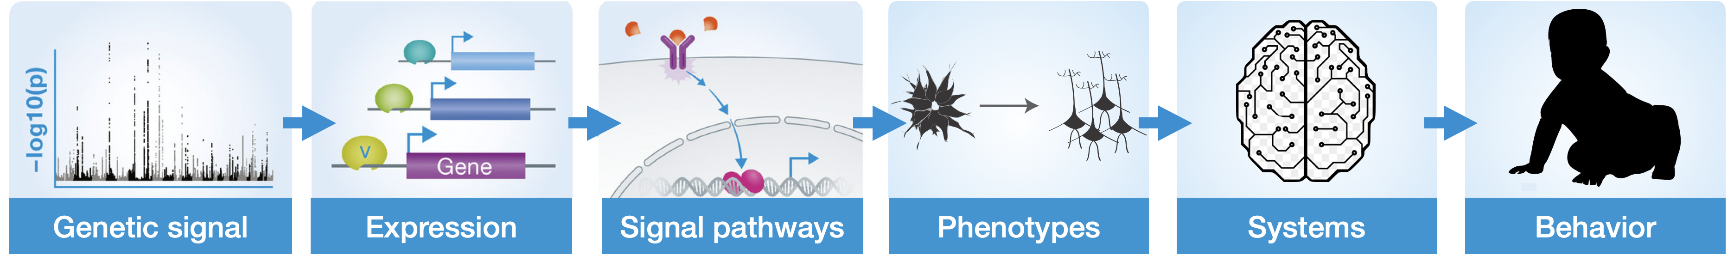
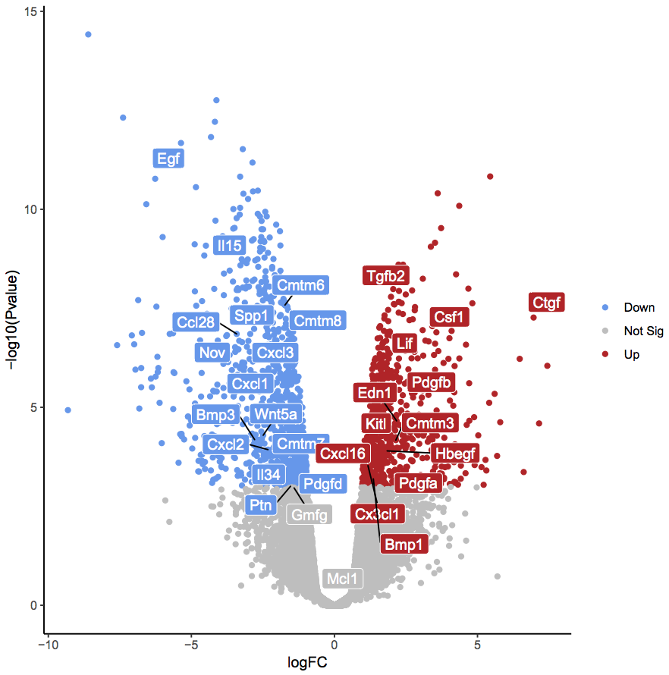
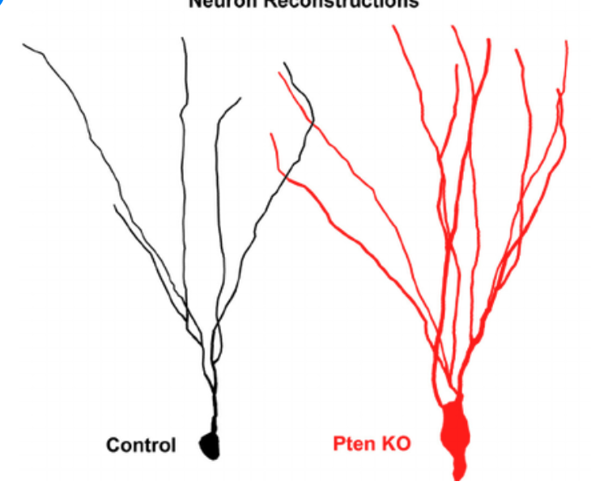
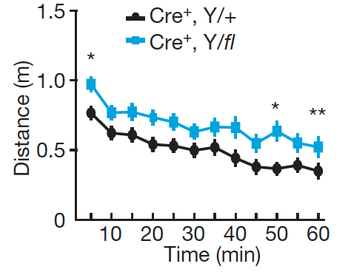
The power of being equipped with statistical tools
How do we make sure our conclusions are meaningful, valid, and reproducible?
Control
Knockout

Slide 4
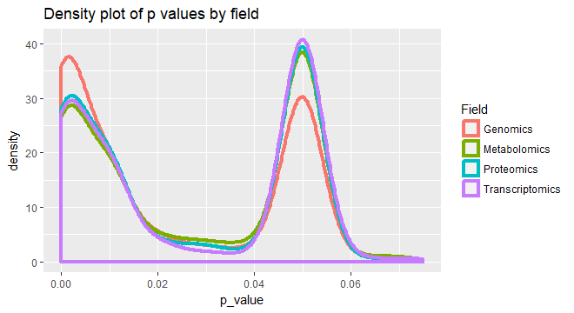
What is p-hacking?
p-hacking (also known as “selective reporting”) is a type of bias in which the experimenter either intentionally or unintentionally exploits analytical tools to misrepresent the true nature of their dataset.
https://medium.com/@danielcanueto/analysis-of-p-hacking-in-metabolomics-data-analysis-cd72c73a43b5

Slide 5
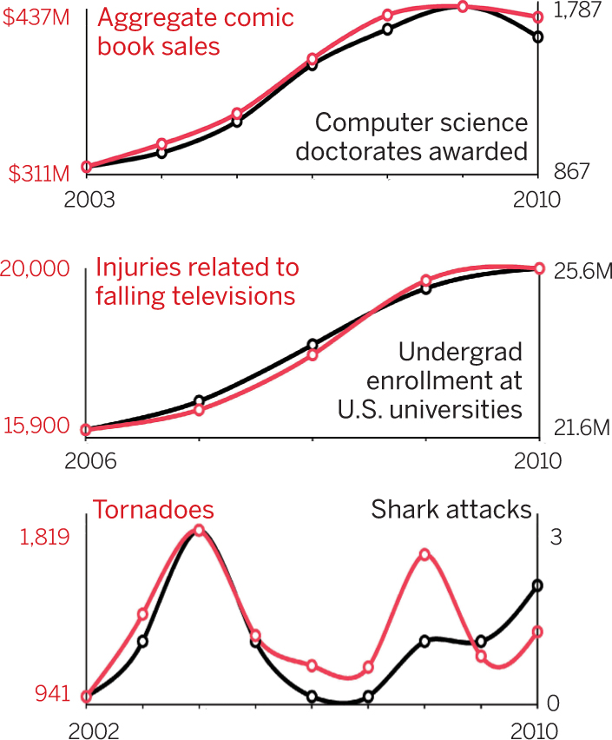
How do you p-hack?
Data dredging is when you perform many statistical tests and only report the ones that reach statistical significance
Example: You collect data that includes 1000 different variables and compare them to each other in a pairwise fashion. You then report significant associations *without any correction for multiple testing*.
https://www.science.org/doi/10.1126/science.aac5518
Notes:
There is a fine balance between exploratory data analysis and p-hacking

Slide 6
How do you p-hack?
Throw out data points without justification
Analyze many measures, but only report those with p < 0.05
Changing analytical tool for no reason or continuously re-analyzing data until p < 0.05
Adding covariates unnecessarily to linear regression models
Stop data collection once p < 0.05
Transform data to get p < 0.05
Don’t correct for multiple testing

Slide 7
How do you avoid p-hacking?
Run outlier tests before removing data points
Design models based on pilot data or published reports
Design experiments with specific sample size in mind
If you find an interesting relationship through data mining, test this hypothesis in a separate dataset
Correct for multiple testing

Slide 8
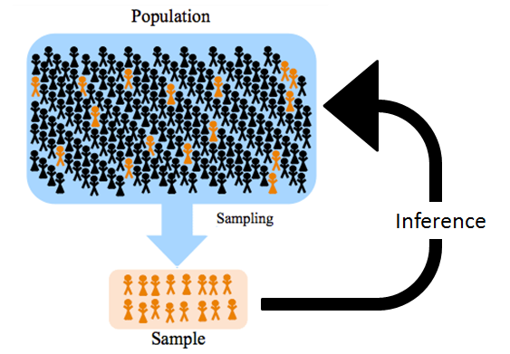
Correcting for Multiple Tests
P-value is a simple probabilistic statement of what is the likelihood of getting specific data based on some assumptions.
If I run the same experiment 100 times, we accept that 5 runs may not be representative of the true population (e.g. false positive).
What do we do?

Slide 9
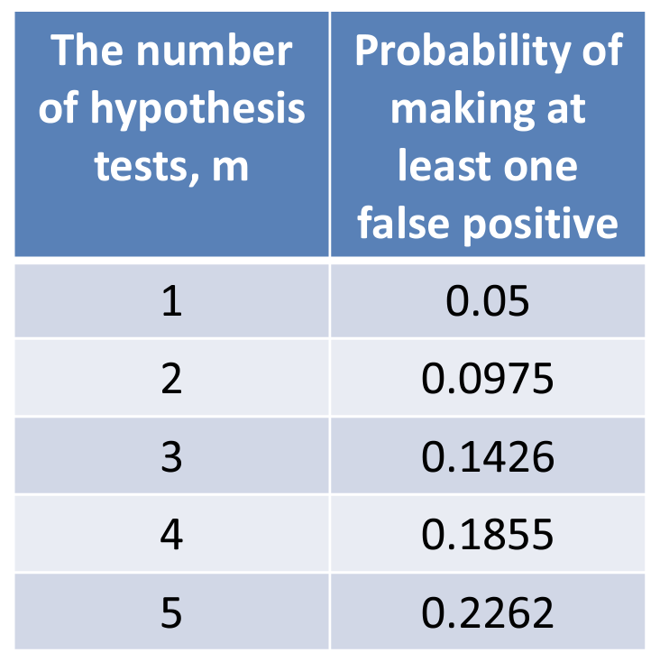
Bonferroni Correction
Bonferroni correction compensates for additional comparisons by testing each hypothesis at a significance threshold of 0.05 divided by number of tests.
Probability of at least one Type I error
Calculates a “family-wise” error rate (FWER)
Very conservative & can lead to missed findings
Data independent
Most common because it is easy and can be used with pretty much any test statistic

Slide 10
Bonferroni Correction
Use case: You run an experiment that makes 20 comparisons and expect a 5% false positive rate (i.e. alpha = 0.05). You discover 6 statistically-significant comparisons before realizing you failed to correct for multiple tests. You perform Bonferroni correction with an adjusted p-value threshold of 0.0025. Only 2 measures “survived” multiple corrections.
Before correction (significant comparisons in red)
After correction (significant comparisons in red)
0.671 | 0.782 | 0.819 | 0.633 | 0.049
0.187 | 0.041 | 0.002 | 0.037 | 0.988
0.554 | 0.802 | 0.450 | 0.211 | 0.342
0.116 | 0.031 | 0.099 | 0.001 | 0.171
0.671 | 0.782 | 0.819 | 0.633 | 0.049
0.187 | 0.041 | 0.002 | 0.037 | 0.988
0.554 | 0.802 | 0.450 | 0.211 | 0.342
0.116 | 0.031 | 0.099 | 0.001 | 0.171

Slide 11
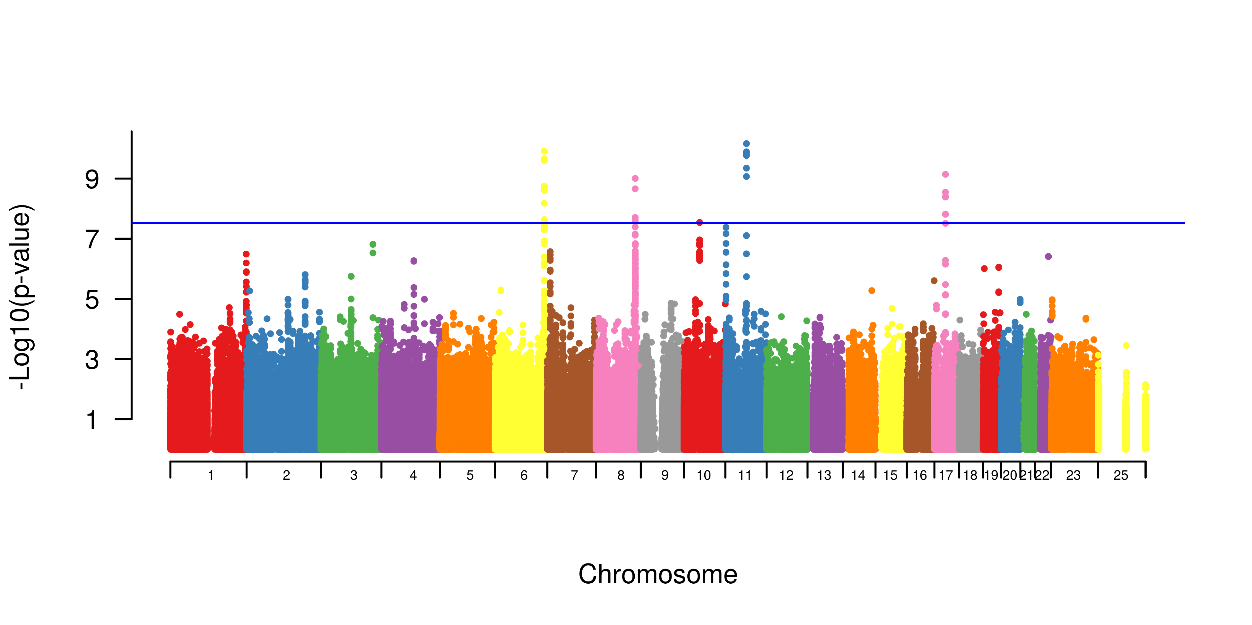
Genome-wide Association Study (GWAS)
Industry standard p-value threshold: $(0.05÷1,000,000 SNPs)$ = 5 x 10⁻⁸

Slide 12
False discovery rate (FDR)
False discovery rate is the fraction of comparisons that are calculated to be statistically significant but are actually null.
Estimates expected proportion of Type I errors among rejected null hypotheses
Less conservative than Bonferroni which states that 5% of ALL comparisons are actually null
Often calculated using Benjamini-Hochberg procedure
Common in genomics and RNA sequencing analysis
Reduces potential chances of missed findings
q-value: p-value that has been adjusted for the FDR
Notes:
There is a fine balance between exploratory data analysis and p-hacking

Slide 13
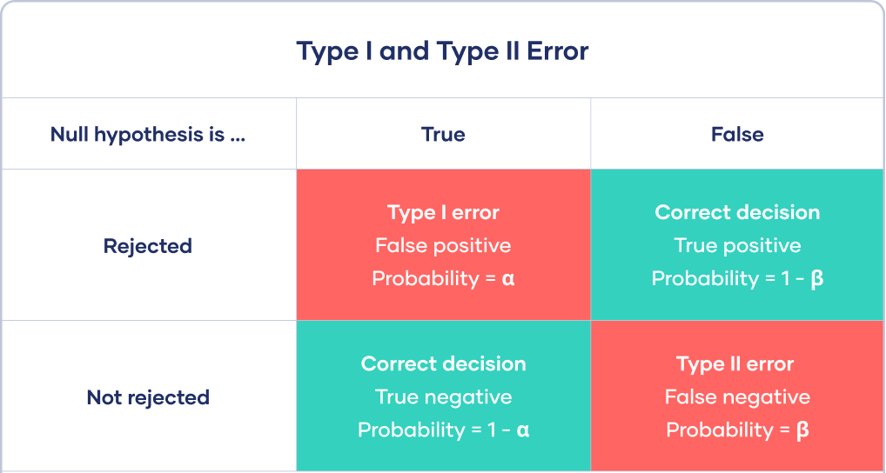
Downsides to multiple testing correction
Decreases Type I error, but increases Type II error

Slide 14
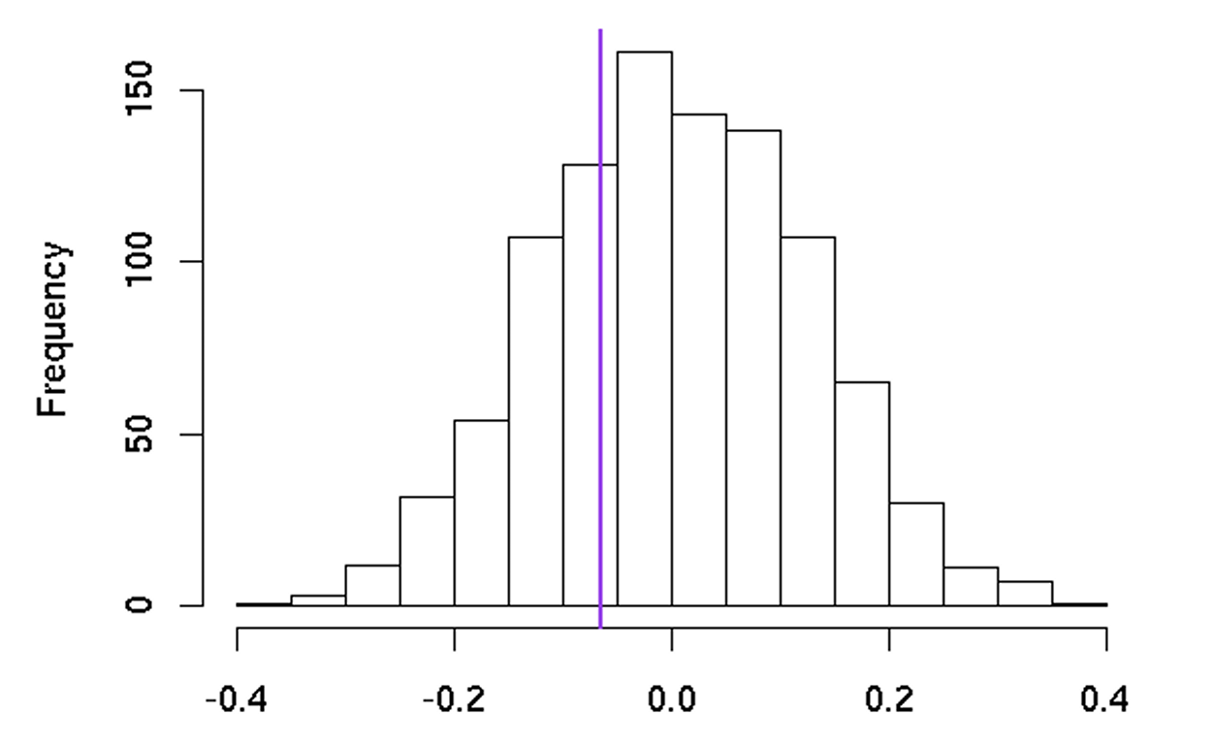
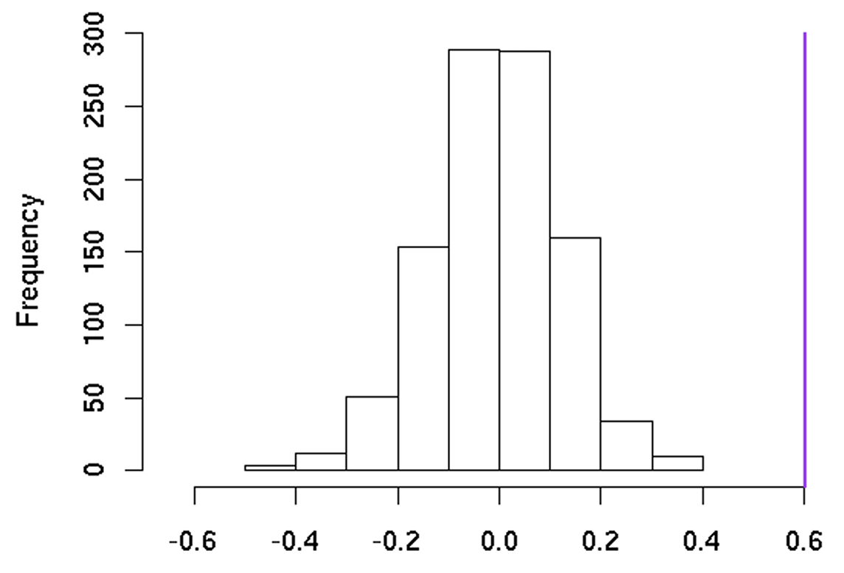
Permutation testing
Permutation testing is a type of randomization test in which observed test statistics are compared to a sampling distribution built by resampling observed data over and over
Uses the proof by contradiction concept by assuming the two groups come from the same population (null: Group A = Group B) and then testing hypothesis by randomly mixing data points and recalculating test statistic
Works best for t-tests and ANOVA
p = 0.617
p = 0.001
Notes:
https://www.jwilber.me/permutationtest/
https://bookdown.org/content/50286a34-7e39-4500-8dd2-62bf686c1710/permutation-testing.html

Slide 15
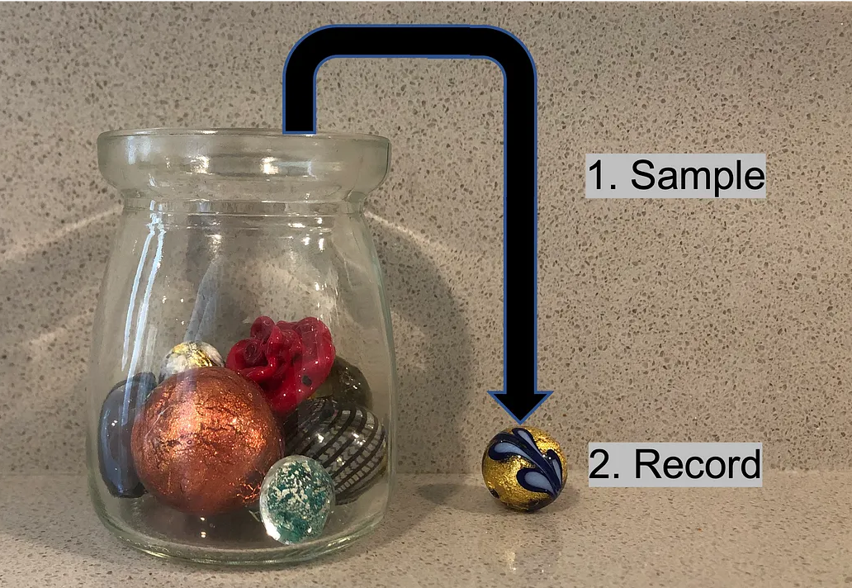
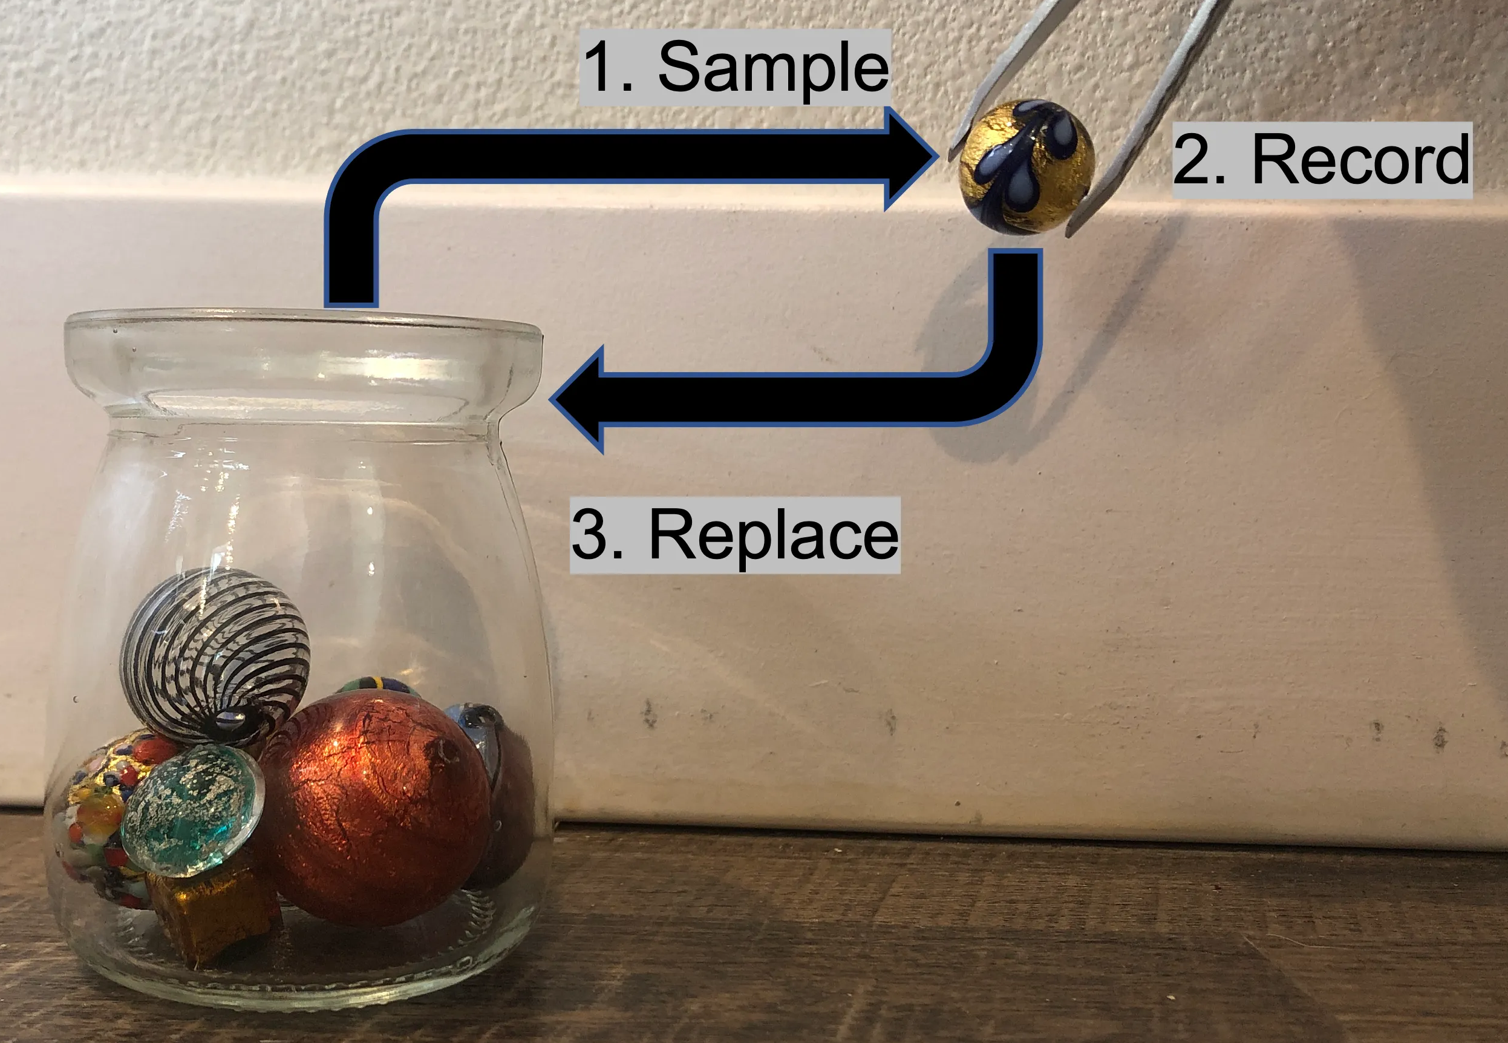
Permutation Procedure
Sampling WITHOUT replacement
State your null hypothesis (Group A = Group B)
Choose a test statistic (difference in means)
Compute the observed test statistic
Rearrange the data points across Group A and B and compute difference in means each time
Repeat Step #4 thousands of times (or all possible permutations) WITHOUT replacement
Examine where the observed data falls in the distribution of the permuted data
Reject the null hypothesis (i.e. there IS a difference between groups) if the value of the observed data is an EXTREME in he permuted distribution.
Sampling WITH replacement
Notes:
https://www.jwilber.me/permutationtest/

Slide 16
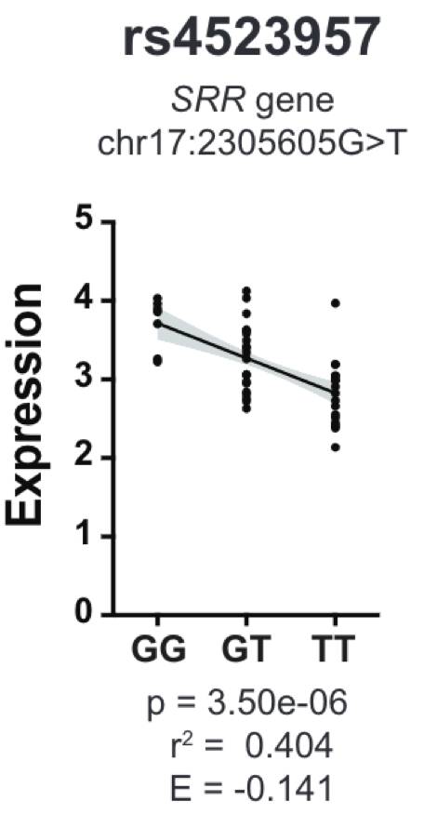
Expression QTLs
Use Case: You are trying to test for associations between individual single nucleotide polymorphisms and the expression of nearby genes (i.e. expression quantitative loci or eQTL).Using r² as your test statistic, you rearrange SNP genotypes 1,000 times.
For the rs4523957 SNP association with SRR gene expression, no permuted r² is greater than the observed r² of 0.404. Therefore, p = 1/1000 or 0.001.
Typically, this SNP would undergo additional permutations (10,000 to 100,000) to allow p-values as low as 0.00001.
Notes:
https://www.jwilber.me/permutationtest/

Slide 17
Bootstrapping
A self-starting process that is supposed to proceed without external input
If we had access to parallel universes, we could replicate our study many times to produce a distribution of all likely results
Use our data to create such ‘parallel’ scenarios
Instead of sampling a population many times, we resample our single sample
Key feature: random sampling with replacement

